Slide 1
PowerCo Customers Churn
Data Science Virtual Experience Program
08/2023

Slide 2
Executive summary
Situation
PowerCo - a major gas and electricity utility is experiencing a significant customer churn due to the power-liberalization of the energy market in Europe
Questions
Customer churn is driven by price sensitivity
The discount of 20% offered to customers is a good measure
Answers
Price is not the main contributor to churn but the margin and consumption
The optimal cutoff point for churn probability is 0.49 to balanced out the loss of 20% discount
Further analysis needs to be taken for selecting the optimal discount and other measures

Slide 3

Tables of contents
Exploratory Data Analysis
Feature Engineering and Modeling
20% Discount Impact

Slide 4
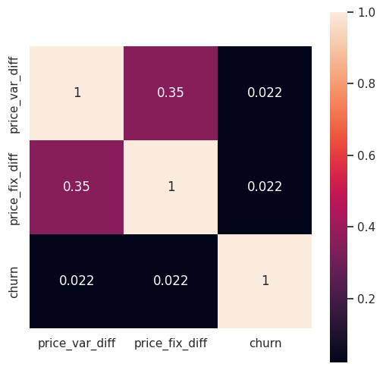
Exploratory Data Analysis
The correlation values between the changes in price and churn is low which shows no clear correlation of price sensitivity and churn.
Heatmap of correlation between changes in price and churn

Slide 5

Feature Engineering and Modeling

Slide 6
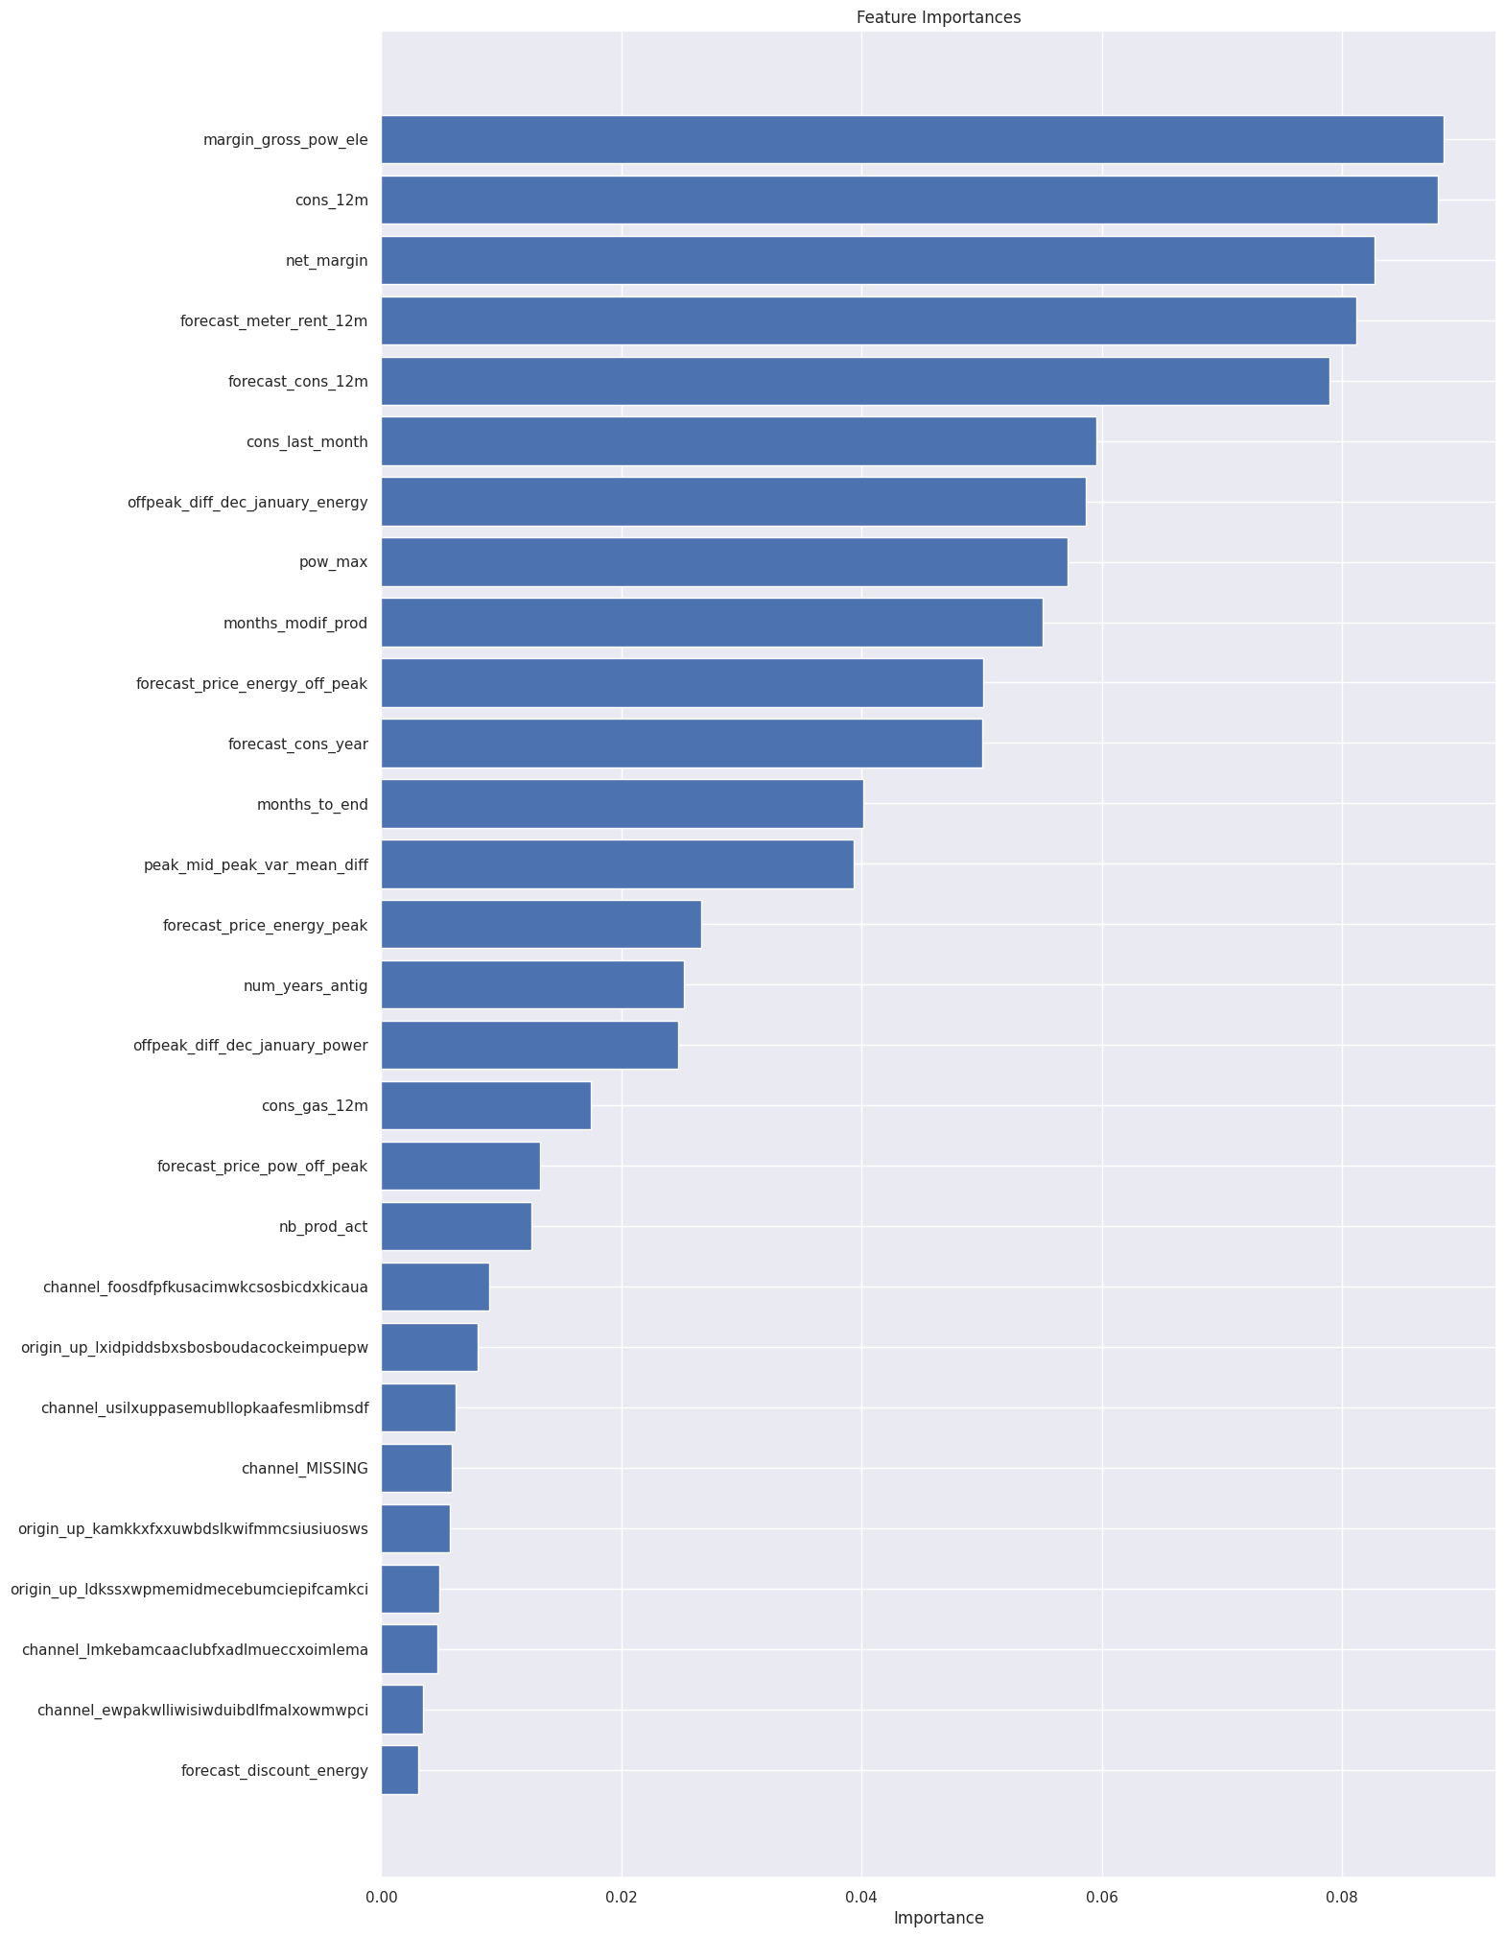
The bar graph shows the importance of features to the model prediction.
Net margin and consumption over 12 months is a top driver for churn in this model
Time seems to be an influential factor
Price sensitivity features are scattered around

Slide 7
The bar graph shows the importance of features to the model prediction.
Margins and consumption over 12 months is a top driver for churn in this model

Slide 8
The bar graph shows the importance of features to the model prediction.
Time seems to be an influential factor
Sales channels and the first campaign each client signed up for do not contribute much to this model

Slide 9
The bar graph shows the importance of features to the model prediction.
Price sensitivity features are scattered around => Weak contributors

Slide 10

20% Discount Impact

Slide 11
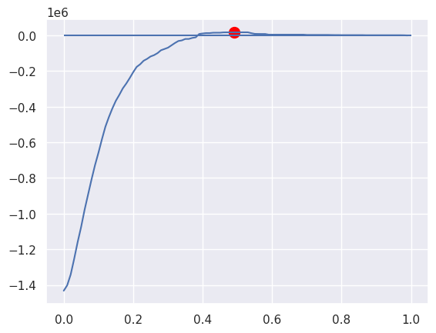
For the 20% discount, from 0 to 1 with the increment of 0.01, the difference between TP and FP is calculated to find the optimal point.
TP: True Positive:how the revenue retention compared to no discount revenue
FP: False Positive: the reduced revenue for giving the customers who aren't actually churn the discounts
Optimal cut-off point for balanced out the revenue loss
Maximum benefit at cutoff 0.49 with revenue delta of $17,541.88

